Slide 1
LIS Admin Presented by Peggy Steele and Jane Blackmar Lab Implementation

Slide 2
Printer Installation

Slide 3
Printer Installation
Very general steps to setting up a printer:
Add IP address to the etc/hosts file or config.sys file
Add the queue to the config file (definition of the physical queue on the UNIX server)
Add the printer to the printerc file (link between printer name defined in SCC modules and the printer queue defined on the UNIX server)
Add the printer to the appropriate Users/Roles, and Sites using Security Management
Notes:
SCC does the first three. Client does the last one

Slide 4
Printer Installation
Type, Brand and Model of the printer.
Type of connection to the LIS
Terminal Server
Jet Direct
Network
Other Requirements
IP address
Port ID (if needed)
Gateway address (if needed)
Name (first three characters must be unique)
Notes:
To get a printer queue made

Slide 5
Maintenance

Slide 6
Maintenance
Check console messages/Monitor email for SPN
Check printer status
Check Remote Printing Modem and Fax Logs and Status
Check Interfaces and possible trace files
Check error logs, specifically ADT, OEHIS, and SFS
Check email for TMS task updates, and Backup Status.

Slide 7
Maintenance
Check console messages/Monitor email for System Problem Notification (SPN) system.
Check printer status
Check Remote Printing Modem and Fax Logs and Status
Check Interfaces and possible trace files
Check error logs, specifically ADT, OEHIS, and SFS
Check email for TMS task updates, and Backup Status.
Notes:
More periodic maintenance. Subsequent slides describe how to perform

Slide 8
Maintenance- Check Printer Status
Tools>Utilities>Check Printers
Displays all queues in a Not Ready Status
Tools>Utilities>Printer Status
Displays status of all printers defined in printerc
Cancel, restart, or both cancel and restart the print jobs
Perform on both MAIN and AUX

Slide 9
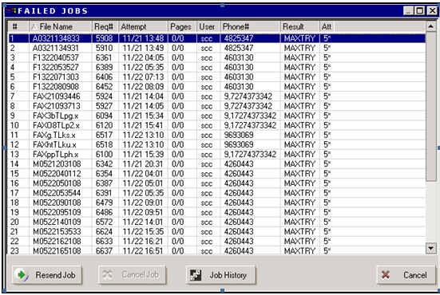
Maintenance- Remote Printing Status
Several times per day
Interfaces-> Remote Printing-> Fax Failed Logs

Slide 10
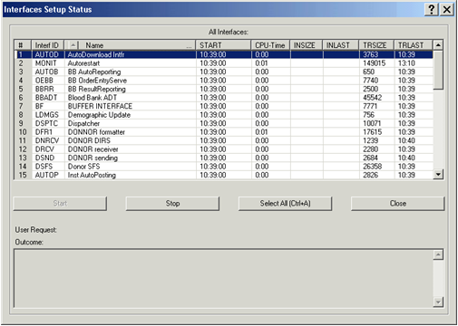
Maintenance- Interface Status
Interface>All Interfaces>Status Screen

Slide 11
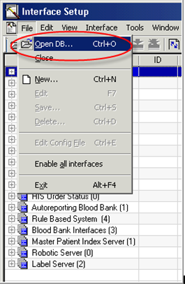
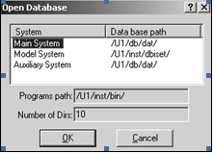
Maintenance Bridging to AUX
Notes:
Look at interface setup on both MAIN and AUX.

Slide 12
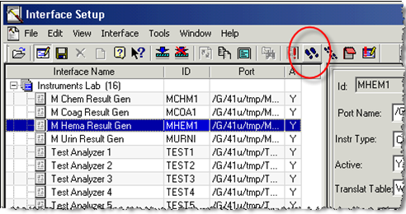
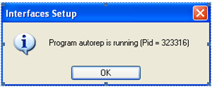
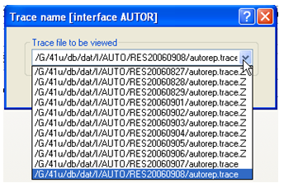
Maintenance- Accessing Trace Files
Notes:
Go to Interface Setup, click on the black shoe prints. Make sure the interface/server is running. Select the correct day’s file.

Slide 13
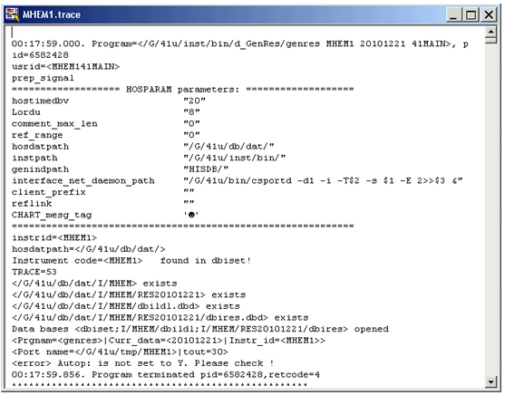
Maintenance- Accessing Trace Files
Notes:
In 4.5, the trace files are very large and it is difficult to load the entire trace file much less look at it. To overcome this, you are first presented with a search screen. Enter the info you are searching for. The system will return every instance where that info is discussed plus the 5 lines about and 20 lines after. You can increase the number of lines if you want to.
The second line is about the tail of the trace- you can see the last 80 lines (by default) of the file. You can also change the number of lines here.
To see the entire file, do not enter anything and just hit search. But don’t be surprised if the file is too huge to open!

Slide 14
Maintenance- Backups
Backup Types
Database (Aux only):
Daily
Includes database, configuration files and dictionary files for each application.
patient data (daily changes)
Software: (AUX)
At least once/month. Twice if in Implementation. After new software load.
Application, executable, configuration
Operating System (MAIN and AUX):
Monthly. Before/After change to operating system
AIX (also called mksysb by IBM)

Slide 15
System Problem Notification (SPN)

Slide 16
SPN
Preventive system monitoring service
Messages directed to SCC personnel
TMS task created to address any issues.
Three levels
Alarm- immediate threat to system stability
Warning- attention needed
Notice- potential threat
Categories
System
Product
Notes:
Soft will notify you of any SPN’s and what is being done about them via the task system.

Slide 17
HIS Interface Communication

Slide 18
5 major interfaces models
ADT
Inbound Order Entry
Outbound Order Entry
Result Reporting
Billing
Notes:
• ADT Admission, Discharge and Transfer– Relays information regarding Patient Demographics and Stay information.
• HISOE/ESB-OE Inbound Order Entry – Sends orders from the HIS to the LIS.
• Outbound Order Entry – Sends orders originating in SCC to the HIS.
• ESB-RR Result Reporting– Transmits results to the HIS.
• Billing – SCC formats and transmits charge information to the HIS.

Slide 19
Communication with HIS accomplished through two or three connections:
RCV
SND
BILLS
Notes:
• RCV Receiving interface - Receives data in real time from a foreign system and passes the information to ADT and inbound order entry.
• SND Sending interface– Sends outbound formatted data such as outbound orders and results to a foreign system. May also send charges.
• BILLS Billing interface – sends formatted charge files to a designated address by file transfer protocols.

Slide 20
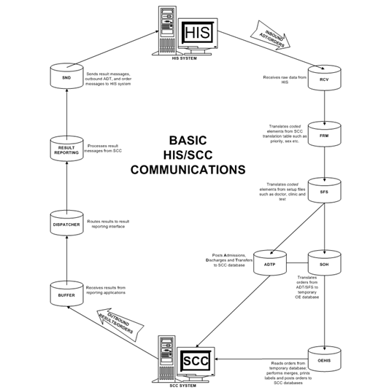
Notes:
This is how 4.0 communicates with the HIS

Slide 21
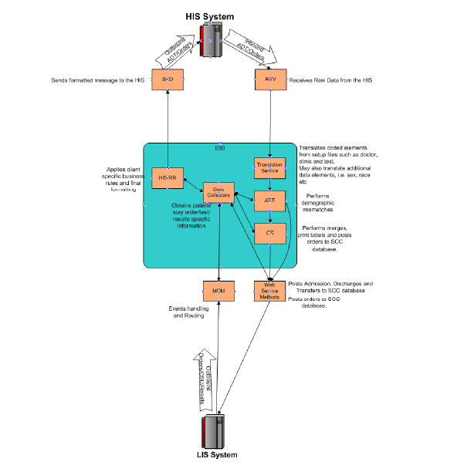
ESB Interface Overview (4.5)
Notes:
How 4.5 communicates with the HIS

Slide 22
HL7 Standards

Slide 23
HL7 Standards
Developed in 1987
Health Level 7
Provides data communication standards for healthcare industry.
Packaged in the form of messages
Message Type – defines message purpose
Event Code – describes event that caused the message.
Segments.- logical group of data making up message
Fields.- collection making up segment

Slide 24
HL7 Standards- Message Type
ADT – admission, discharge, transfer, merge
ORM – orders, cancellations, order status changes
ORU – results of orders
DFT – financial

Slide 25
HL7 Standards- Trigger Events
ADT Events - admitting a patient
Order Events - creating an order
Result Events - entry of a result
Financial Events – transmitting a charge for a service

Slide 26
HL7 Standards- Segment
Has a defined structure
Is identified by a unique 3-character code.
Is comprised of a specific set of related fields.
May occur with the message once or many times.
May be required or optional depending on HL7 standards.
Ends with special characters, usually \r.

Slide 27
HL7 Standards- Segment
MSH - Message Header is required to communicate type of message
EVN - Identifies triggering event
PID - patient demographics.
PV1 - Patient Stay info.
PV2 - More Patient Stay info
NTE - free text comments or report data.

Slide 28
HL7 Standards- Segments
Order Entry Specific Segments
ORC –Transmits Common Order fields that may be grouped together.
OBR – Defines specific test related data (Observation Request) and is used to transmit information specific to an order.
Result Entry Specific Segments
OBX – Observation sends each individual result in a discrete mode. The OBX segment is used for SoftLab to transmit a single observation or result in a structured form.
NTE Segment- used by ADT, Order Entry, or Result interfaces to transmit textual data in a non-discrete format for Patient, Stay, Order, etc comments

Slide 29
HL7 Standards- Data Fields
String of characters, separated from other fields by “|”
References to particular fields within a segment are indicated by [] i.e. OBR[18]

Slide 30
HL7 Standards- Putting it all together

Slide 31
MOM Message Oriented Middleware

Slide 32
MoM (Message Oriented Middleware)
Software or hardware infrastructure
Supports sending and receiving messages between distributed systems.
Allows application modules to be distributed over heterogeneous platforms
Reduces the complexity of developing applications that span multiple operating systems and network protocols.
SCC utilizes MoM for integration with foreign systems, as well as integration between SCC applications.

Slide 33
MoM (Message Oriented Middleware)

Slide 34
MoM (Message Oriented Middleware)
Events in each application generate trigger events (Publish Event)
Publish Event pushed to MoM.
Trigger events/parent messages directed to data collectors to obtain information stored in the modules
Back to MoM.
Additional messages may be generated from MoM to obtain additional information
Routed to ESB for further processing and to be sent to internal/foreign systems (results reporting).

Slide 35
MoM (Message Oriented Middleware)

Slide 36
MoM (Message Oriented Middleware)

Slide 37
Accessing MoM
Many ways to access:
1. SoftLab application Main screen Tools>MOM Console
2. SoftDMI application Main screen by selection of the DMI “url” located on the Status bar.
3. If the host and port are known, you can type in the “url” in your browser (Internet Explorer)

Slide 38
Accessing MoM

Slide 39
Copy Setup

Slide 40
Copy setup
A utility which lets you copy multiple SETUP records between environments
Speeds up file building
Avoid human errors
Protect the integrity of records after copying.

Slide 41
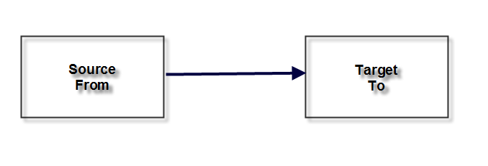
Environments
Source
-The “From”
-By default, the environment from where Copy Setup launched.
-Can be changed by the user after launching Copy Setup.
-The “To”
-Possibly a choice of Targets.
-Choices would include:
-All compatible environments installed on the same PC.
-Those listed in SSM.

Slide 42
Access from Lab, Micro, or SecMan

Slide 43
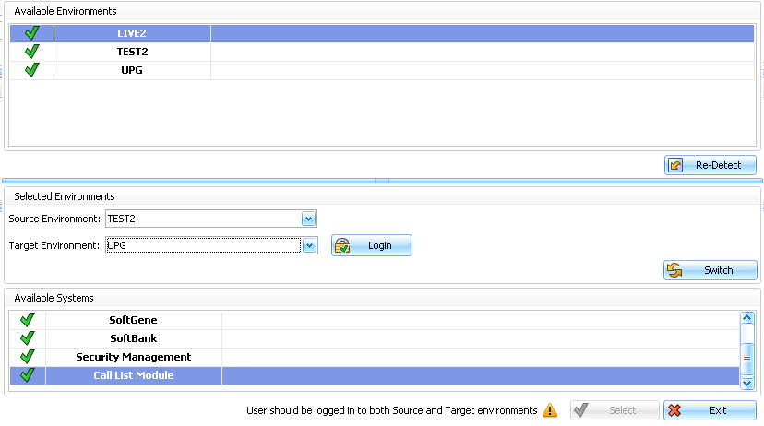

Slide 44
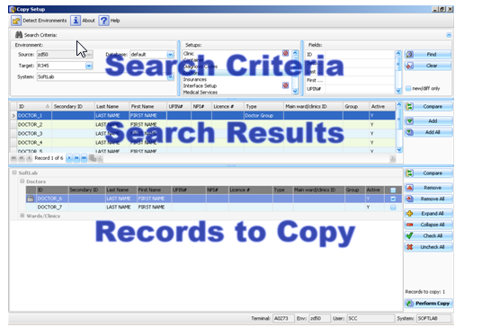

Slide 45
Search criteria
Search criteria from previous screens
List of available setups to copy
List of fields within the setup

Slide 46
Example Search
Select all the active Doctors in TEST2 whose last name is Smith

Slide 48
Example Search Results
Click on Compare

Slide 49
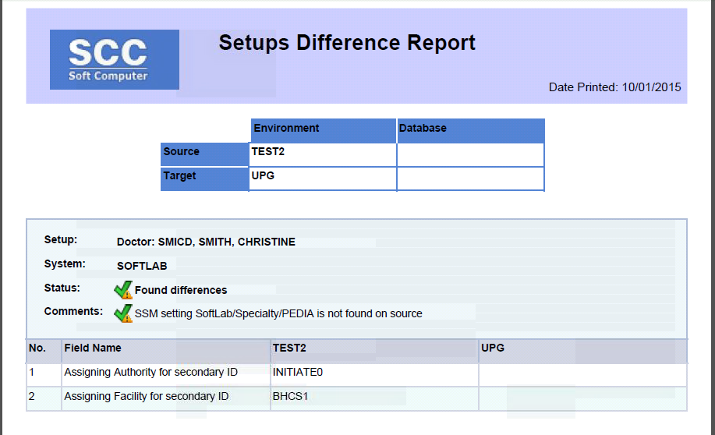

Slide 50
Select the records you want to copy to the Target environment and click Add or Click Add All to copy all the records

Slide 52
Example Records to Copy

Slide 53
Check the record to copy it. Note the lock. Click Perform Copy
If a lock is present. this record becomes locked in the source and target environments. The record can be opened for reading in the source environment but it cannot be changed in the target until the lock is released

Slide 54
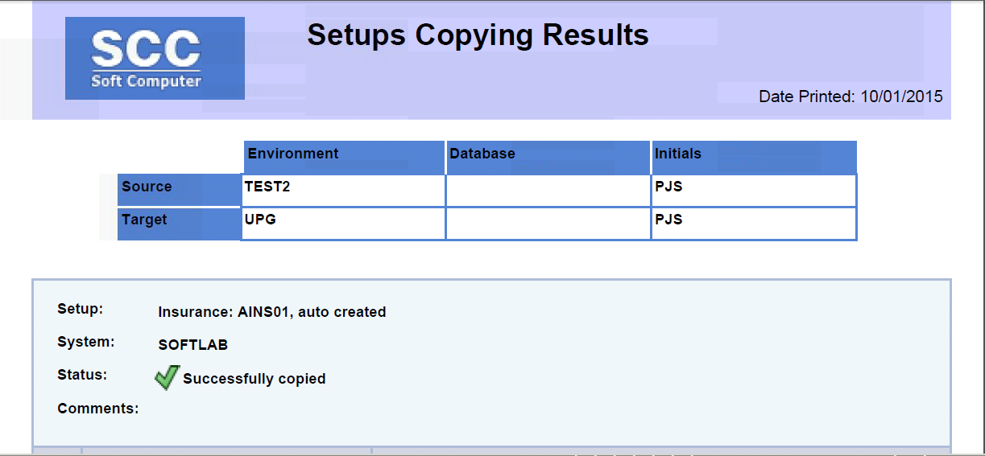
After successful copy, this report will print to the screen.

Slide 55
Unsuccessful Copy

Slide 56
Unsuccessful Copy “Redo”
If you choose (and the differences are not too much), the system will allow you to copy the dependent records in addition to the one(s) you selected.

Slide 57
Security (Only one option)
Option #799 on the Source and Target
(Copy Setup).
to “Read” to records on the Source
(search).
to “Read” to records on the Target
(comparison).
to “Edit/Add” to records on the Target
(copy).

Slide 58
Settings and Definitions

Slide 59
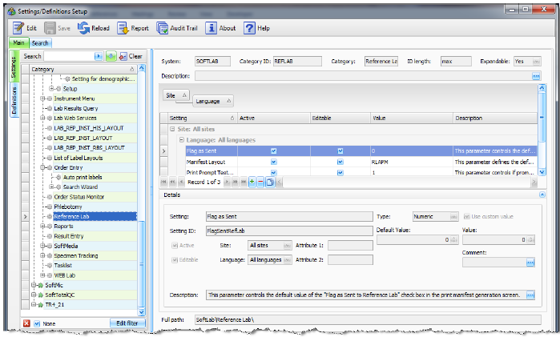
Settings and Definitions (SSM)
Main Menu/Setup/Settings and Definitions

Slide 60
Finding SSM’s

Slide 61
Finding SSM’s

Slide 62
Editing SSM’s

Slide 63
Editing SSM’s

Slide 64
Editing SSM’s

Slide 65
Editing SSM’s

